Slide 1
Minor Project
SMART CONTRACT BASED
AGRI-INSURANCE SYSTEM
Presentation by
PRIYANKA SEN [RA2311050010056]
HARSHITA JAISWAL [RA2311050010053]

Slide 2
SDG Alignment
SDG Number: 1
SDG Name: No Poverty

Slide 3
Overview
Introduction
Problem Statement
Need for project
Objectives
Abstract
Proposed solution overview
System Architecture
Technology stack
Module description
Team Roles and Timeline
References
Scrum Based Agile Board

Slide 4
Introduction
Agriculture plays a vital role in the economy, but farmers face significant risks due to unpredictable weather conditions and natural calamities. Crop insurance is intended to protect farmers from financial losses; however, existing systems are often inefficient, slow, and lack transparency. Emerging technologies like blockchain and smart contracts offer a promising solution to improve the reliability and automation of agricultural insurance systems.

Slide 5
Problem Statement
Traditional agri-insurance systems rely heavily on manual processes and intermediaries, leading to delayed claim settlements, lack of transparency, and disputes between farmers and insurers. Inaccurate or manipulated data and limited trust in the system further reduce its effectiveness, causing financial stress to farmers during critical periods.

Slide 6
Need for project
Agriculture plays a vital role in the economy, but farmers face significant risks due to unpredictable weather conditions and natural calamities. Crop insurance is intended to protect farmers from financial losses; however, existing systems are often inefficient, slow, and lack transparency. Emerging technologies like blockchain and smart contracts offer a promising solution to improve the reliability and automation of agricultural insurance systems.

Slide 7
References
Blockchain Oracles for Decentralized Agricultural Insurance (Frontiers in Blockchain, 2025)
https://www.frontiersin.org/articles/10.3389/fbloc.2024.1481339/full
Description:
This paper proposes a decentralized agricultural insurance framework using blockchain and oracle networks. It focuses on improving trust and transparency in weather-based insurance claims.
Methodology:
The authors design a decentralized oracle network integrated with smart contracts. IoT-based weather data is verified and passed to blockchain for automated claim validation.
Research Gap:
The study lacks large-scale real-world deployment. It does not analyze farmer usability or transaction cost optimization in practical scenarios.

Slide 8
Blockchain Based Crop Insurance: A Decentralized Insurance System (Sustainability, 2021)
https://www.mdpi.com/2071-1050/13/16/8921
Description:
This research presents a decentralized crop insurance model using Ethereum smart contracts. It aims to automate payouts and reduce fraud in traditional systems.
Methodology:
Smart contracts are deployed on Ethereum to store policies and execute predefined payout conditions based on weather thresholds.
Research Gap:
The system is mainly prototype-based and lacks real-time oracle integration. Scalability and gas cost issues are not thoroughly evaluated.

Slide 9
Trusted IoT Data Sharing and Oracle Access for Agricultural Risk Management (Comp. & Electronics in Agriculture, 2023)
https://www.sciencedirect.com/science/article/abs/pii/S0168169922008523
Description:
This paper focuses on secure IoT data sharing for agricultural risk management using blockchain. It enhances trust in external data sources.
Methodology:
The model combines IoT sensors, decentralized identity systems, and blockchain to verify agricultural data before sending it to smart contracts.
Research Gap:
The study does not implement a complete automated payout mechanism. It also lacks cost-effectiveness analysis and field testing in real farm environments.

Slide 10
Trusted IoT Data Sharing and Oracle Access for Agricultural Risk Management (Comp. & Electronics in Agriculture, 2023)
https://www.sciencedirect.com/science/article/abs/pii/S0168169922008523
Description:
This research introduces a peer-to-peer crop insurance model where farmers collectively share risk without traditional insurance companies.
Methodology:
Blockchain smart contracts are used to pool funds and distribute payouts among participants based on predefined risk-sharing rules.
Research Gap:
The framework does not integrate real-time weather oracles. It also lacks regulatory considerations and scalability testing for large user bases.

Slide 11
Decentralized Peer-to-Peer Crop Insurance (ACM, 2021)
https://dl.acm.org/doi/10.1145/3457337.3457837
Description:
This research introduces a peer-to-peer crop insurance model where farmers collectively share risk without traditional insurance companies.
Methodology:
Blockchain smart contracts are used to pool funds and distribute payouts among participants based on predefined risk-sharing rules.
Research Gap:
The framework does not integrate real-time weather oracles. It also lacks regulatory considerations and scalability testing for large user bases.

Slide 12
Smart Contracts Based Automated Payouts Crop Insurance (IJIRSET, 2025)
https://www.ijirset.com/upload/2025/may/174_Smart.pdf
Description:
This study proposes a blockchain-based crop insurance system that automates claims using predefined rainfall thresholds.
Methodology:
Smart contracts are programmed to monitor rainfall data and trigger automatic payouts when the specified condition is met.
Research Gap:
The system remains at prototype level and lacks security audits, performance benchmarking, and real-world deployment validation.

Slide 13
Objectives
01
To design a blockchain-based agri-insurance framework
02
To automate policy execution and claim settlement using smart contracts. To reduce fraud, delays, and manual intervention
03
To integrate oracle-based external data for objective claim decisions. To enhance transparency and trust among stakeholders

Slide 14
Abstract
This project proposes a blockchain-based agri-insurance system to address issues such as delayed claim settlement, lack of transparency, and manual intervention in traditional crop insurance. Smart contracts are used to automate policy execution and claim processing, while an oracle mechanism provides external data such as rainfall information for decision making. Blockchain ensures secure, transparent, and tamper-proof record keeping. The proposed system aims to improve trust, efficiency, and reliability in agricultural insurance services.

Slide 15
Proposed Solution
The proposed system uses blockchain technology to store insurance policies and transactions in an immutable manner. Smart contracts automatically evaluate insurance conditions and trigger claim settlements based on data received from a trusted oracle, such as rainfall information. This approach ensures secure, transparent, and efficient insurance processing with minimal human involvement.

Slide 16
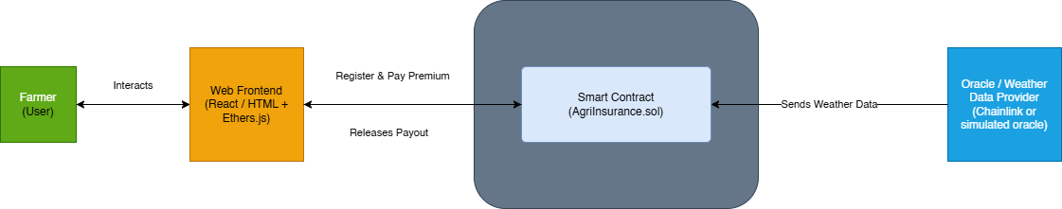
System Architecture
Farmer registers & buys policy
Contract checks threshold
Smart contract stores policy details
Automatic payout if conditions met
Oracle fetches rainfall data

Slide 17
Technology Stack
Blockchain Layer
Frontend
Ethereum / Polygon Blockchain
Solidity (Smart Contract Language)
HTML, CSS, JavaScript
React.js
Oracle Layer
Development Tools
Chainlink Oracle
External Weather APIs (Rainfall data)
Remix IDE / Hardhat
MetaMask Wallet
Git & GitHub
Backend / Integration
Node.js
Web3.js / Ethers.js

Slide 18
Module Description
Farmer Module
Smart Contract Module
Farmer registration
Policy purchase
View policy status
Receive claim payout
Policy creation and storage
Rainfall threshold validation
Automatic claim processing
Secure fund management
Oracle Module
Admin Module
Fetches real-time rainfall data
Sends verified data to smart contract
Ensures trustless automation
Set insurance parameters
Monitor contract activity
Manage policy rules

Slide 19
Team Roles and Timeline
Member 1 (Priyanka Sen)
Member 2 (Harshita Jaiswal)
Smart Contract Development
Blockchain Logic
Testing & Deployment
Oracle Integration
Weather API Handling
Backend Support
Eliminates manual claim processing
Ensures transparency and trust
Reduces fraud and delays
Demonstrates real-world blockchain application in agriculture

Slide 20
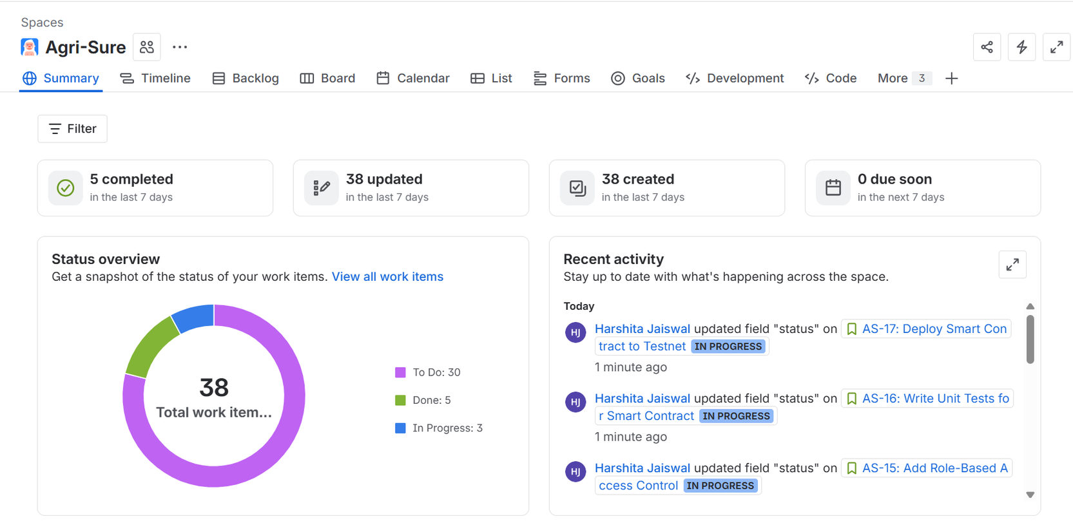
Scrum Based Agile Board

Slide 21
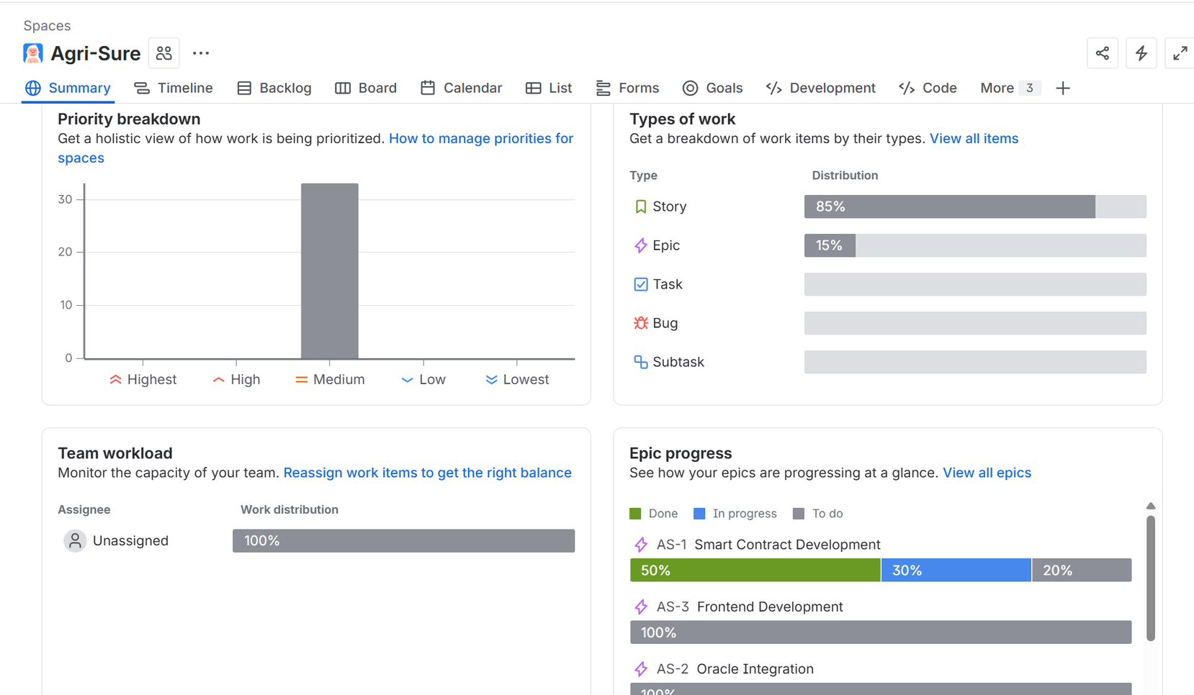

Slide 22

SRM University
09/02
Thank
You
2026
February

